Slide 1
NASA STUDENT LAUNCH
SD T501: The Zenith Program

Slide 2
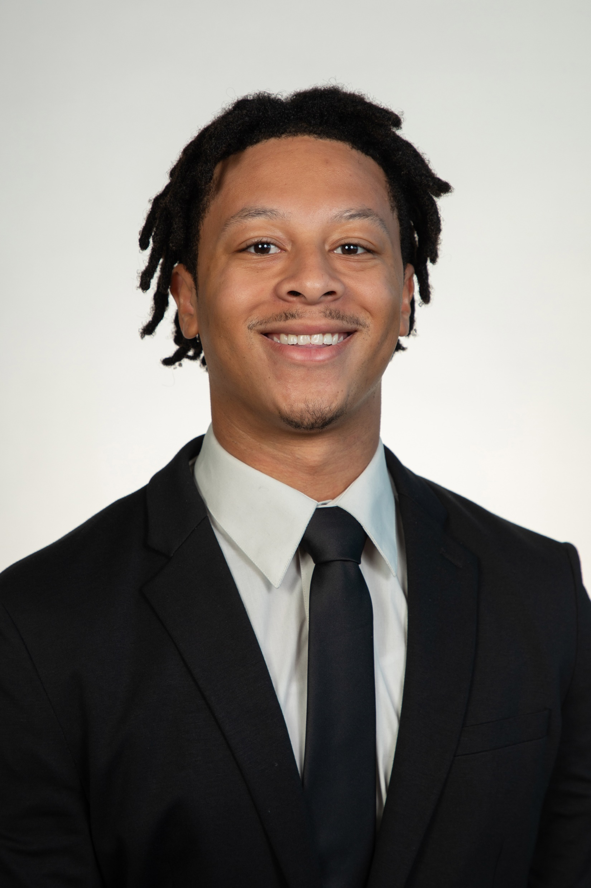
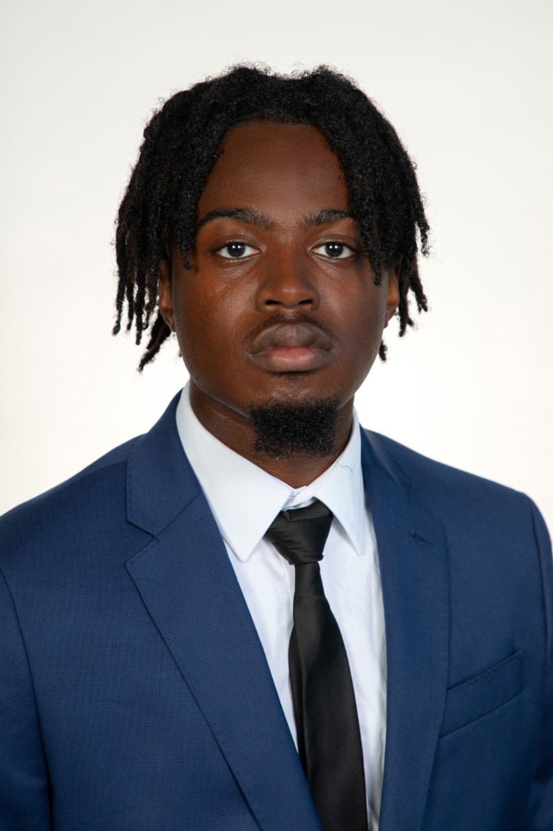
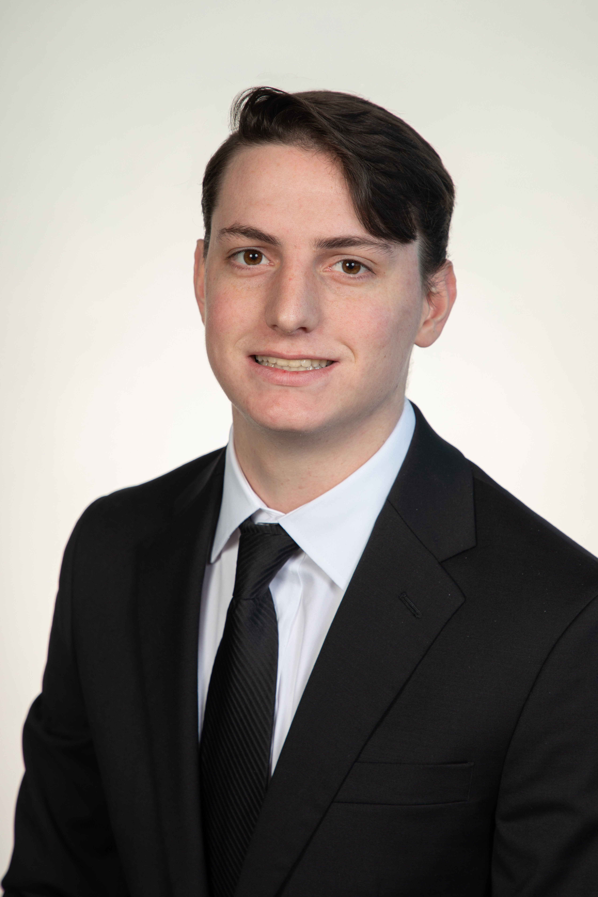
Zenith Program Leads
Jedreck Acquissa
Peyton C. Breland
Dylan A. Gardner
Mark A. Ioffredo
Zachary L. Isriel
Role: Recovery & Avionics System Lead
Engineering Interests: Fluid Design and Food Manufacturing
Role: Propulsion & Vehicle Design Lead
Engineering Interests: Fluid Design, Flight Vehicle Design and Manufacturing
Role: STEM Engagement Lead
Engineering Interests: Fluid design, Heat Transfer, and Manufacturing
Role: Payload System Lead
Engineering Interests: Fluid Design and Aerodynamics
Role: Program Director
Engineering Interests: Human spaceflight, spacecraft R&D, commercial launch

Slide 3
Fall Semester Overview

Slide 4
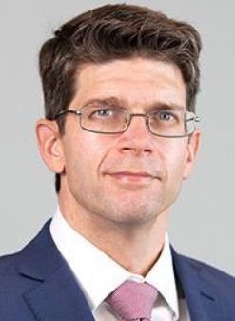
Stakeholders and Roles
National Aeronautics and Space Administration
Launch Service Client
Competition Organizer
Shayne McConomy,
Ph.D.
Functional Manager
ME Senior Design Coordinator
Project Sponsor
Chiang Shih,
Ph.D.
Project Advisor
AME Center Director
AIAA Student Org. Advisor
William Oates,
Ph.D.
Project Investor
ME Department Chair

Slide 5
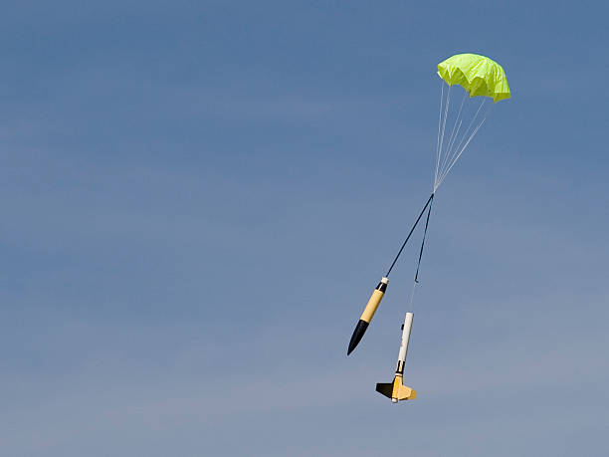
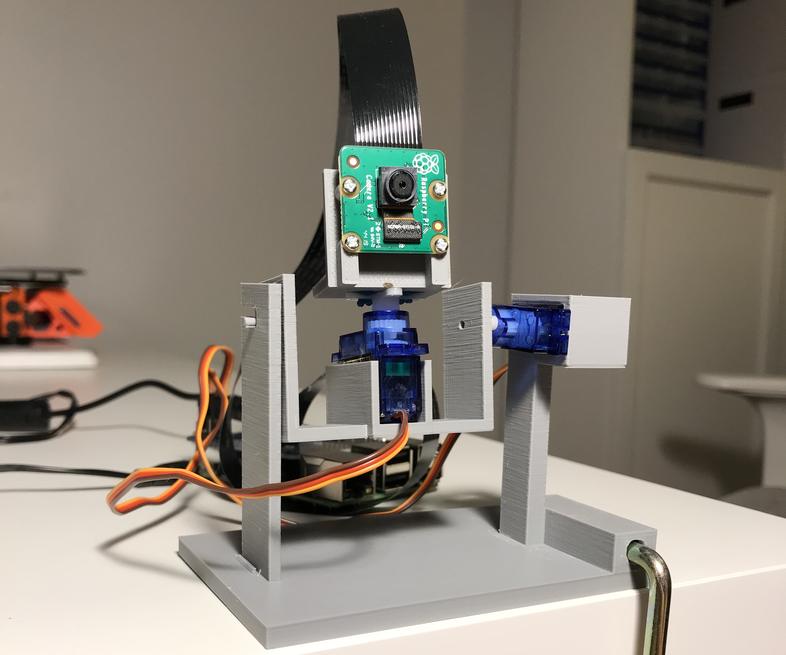
Project Objective
Fly a dual deployment, high-power solid rocket to an altitude between 4,000 and 6,000 feet that will deploy a payload capable of receiving and executing a string of radio frequency after the vehicle and payload are safely recovered within 2500 feet of the launch pad.

Slide 6
Project Scope – Key Goals
Successful and accurate flight tests
From apogee to touchdown in under 85 seconds
Reach within 100 ft of the proposed 4600 ft apogee
Payload is to complete a series of tasks with a scientific purpose
Maintain a mid-flight stability margin between 3 and 4 calibers
Be awarded for at least one of the competition categories

Slide 7
Flight Profile, Vehicle,
and Payload Design

Slide 8
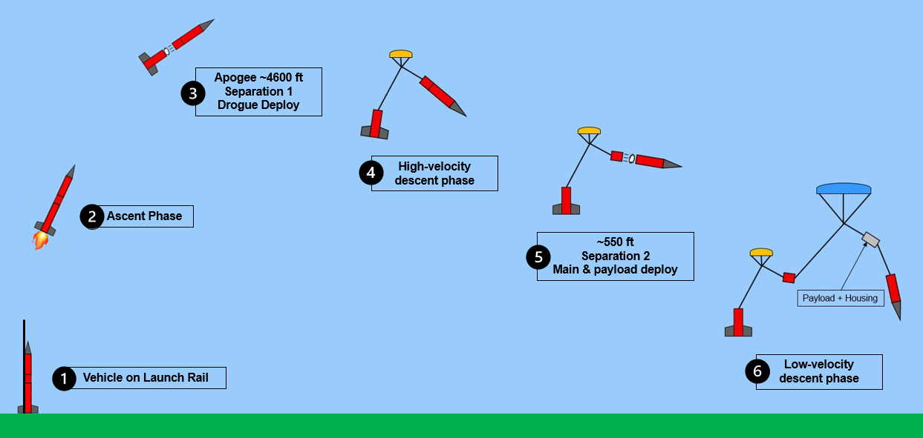
Flight Profile Overview

Slide 9
Launch Vehicle Design
Full Scale Length: 99”
Airframe Diameter: 6.154”
Weight: 38.30 lb
Target Apogee: 4600 ft AGL
Max Velocity: 545 ft/s

Slide 10
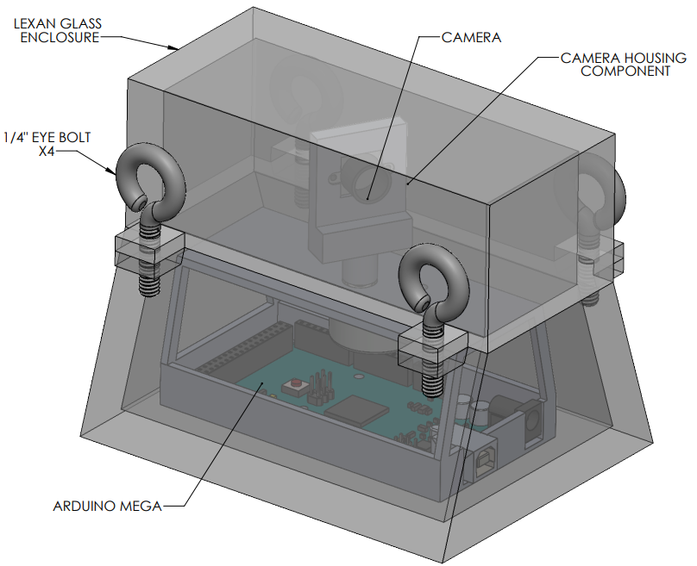
Payload Design
144-148 MHz Receiver
Arduino Mega controller
ArduCam Mini w/ 3D printed turret
Stepper motor
3D printed base
Lexan camera shroud

Slide 11
Subscale Test Vehicle
Launch Results

Slide 12
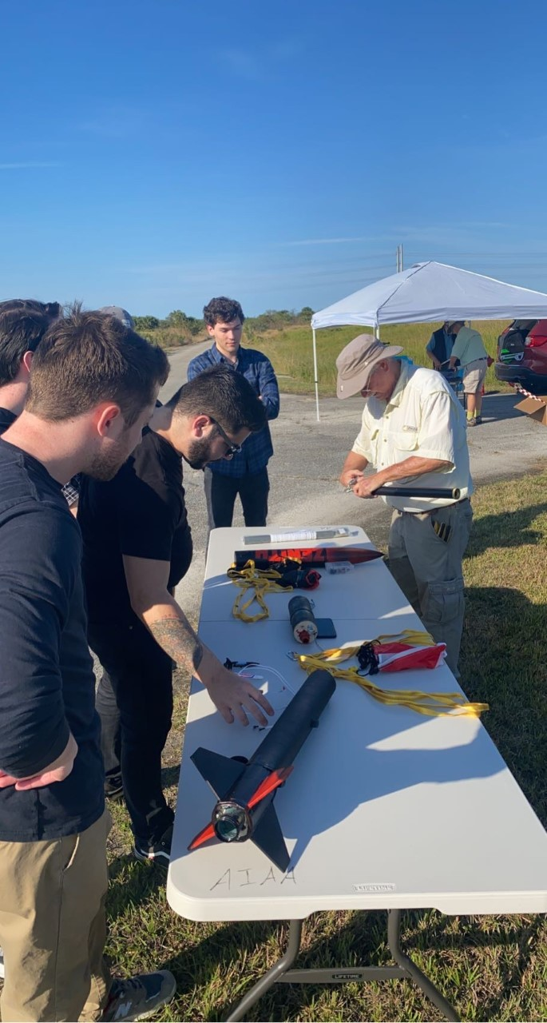
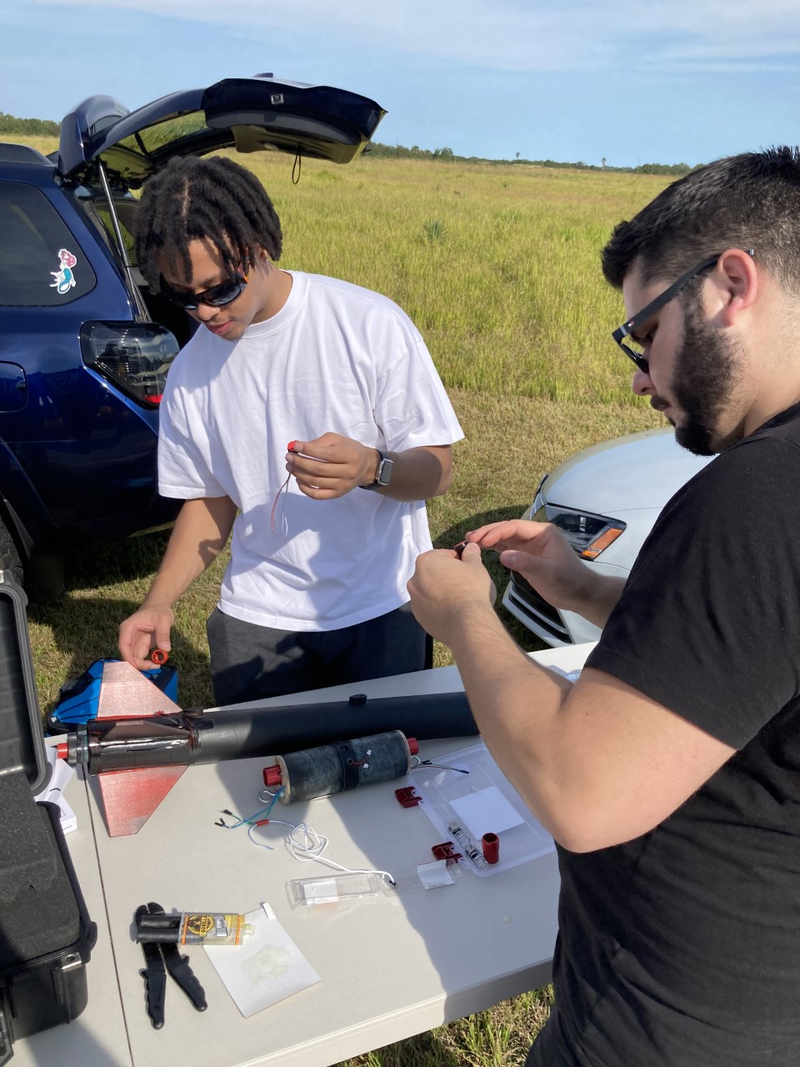
Launch Day Conditions
Date: Saturday, December 17th, 2022
Location: Palm Bay, FL
Weather:
Temperature: 74 °F
Wind: 9 MPH (N → NE)
Scattered high-altitude clouds

Slide 13
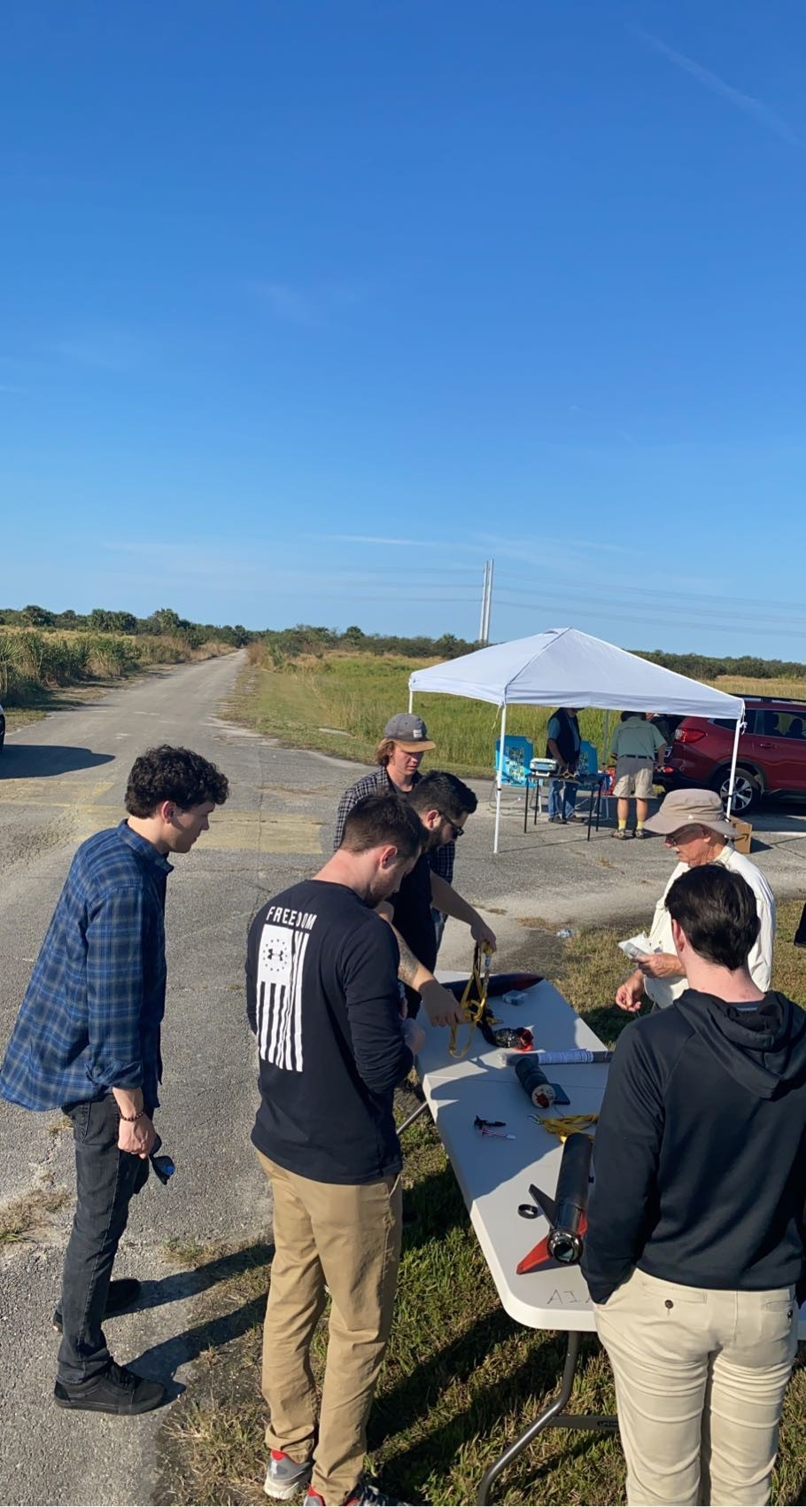
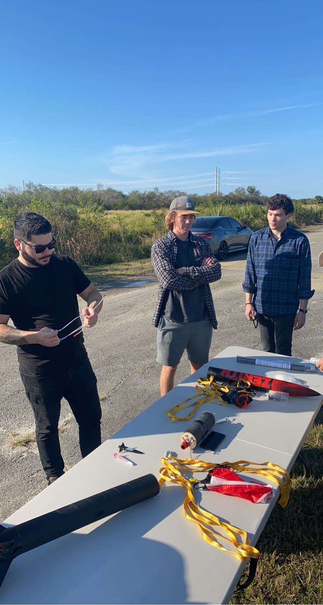
Launch Day Operations
Vehicle made flight ready in 1 hour
JJ lost the tap… never forget
Zack almost passed out from a low BG… forget that pls
Pad loiter time ~10 minutes
Full 2 hours required unexplored
Vehicle disassembled in under 10 minutes
Avionics bay opened and data recovered in under 5 min

Slide 14
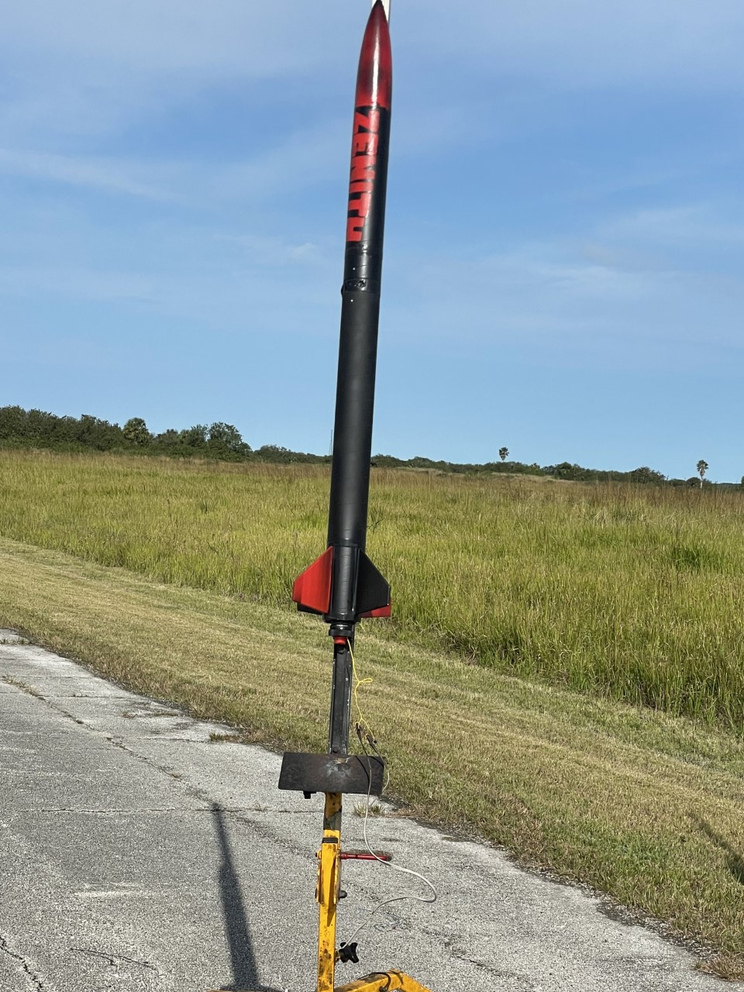
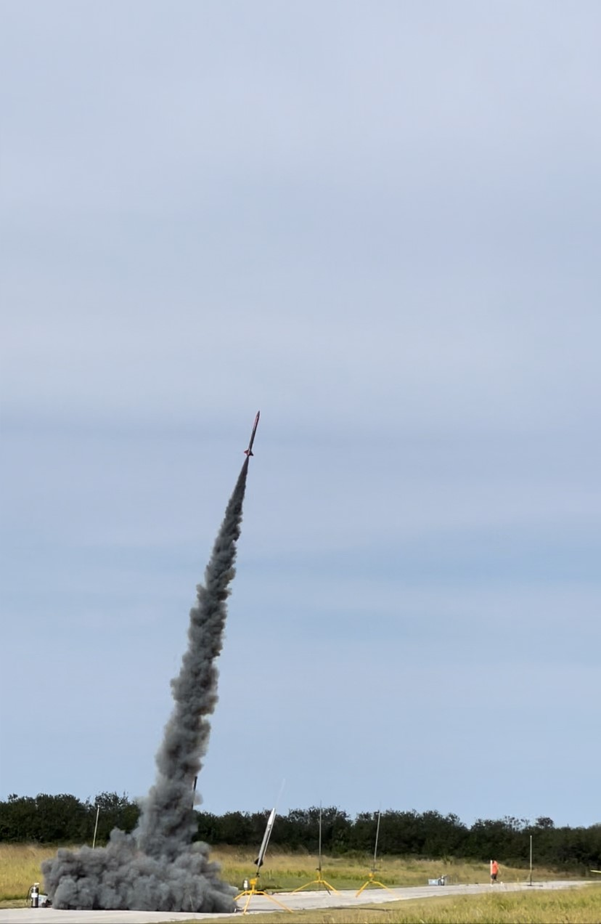
Subscale Launch!

Slide 15
Flight Events
Event | Time (s) | Result
Ignition/liftoff | 0 | Nominal
Burnout | 4 | Nominal
FC read apogee | 15 | Nominal
Fire ejection charge 1 | 16 | Nominal
Separation 1 | 16 | Nominal
Drogue deployment | 17 | Nominal
Separation 2 | 17 | Failure (Class 2)
Main Deployment | 18 | Failure (Class 2)
FC read 550ft AGL | 150 | Failure (Class 1)
Fire ejection charge 2 | 155.5 | Failure (Class 1)
Ground Impact | 184 | Nominal

Slide 16
Flight Events
Event | Time (s) | Result
Separation 2 | 17 | Failure (Class 2)
Main Deployment | 18 | Failure (Class 2)
FC read 550ft AGL | 150 | Failure (Class 1)
Fire ejection charge 2 | 155.5 | Failure (Class 1)

Slide 17
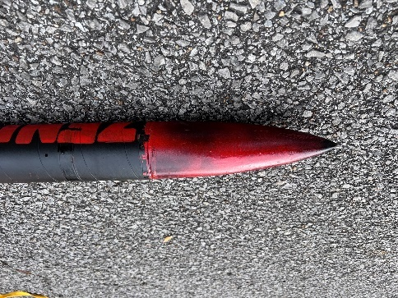
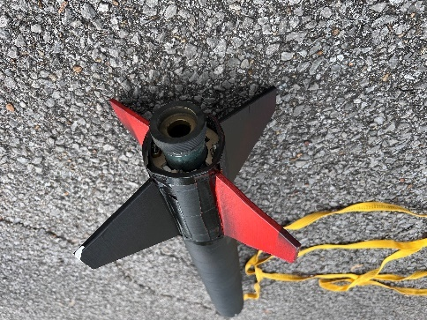
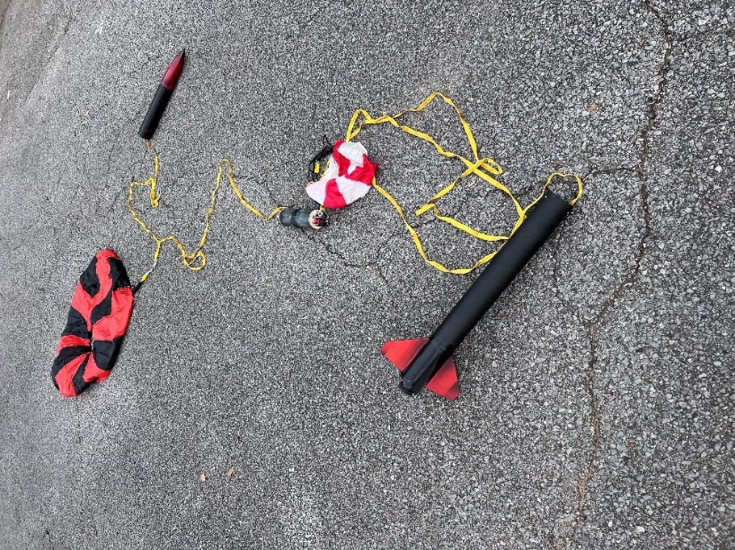
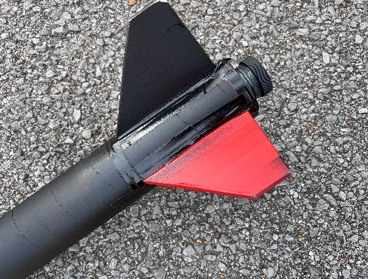
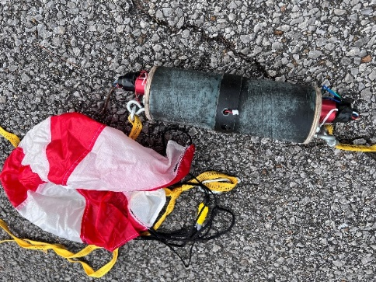
Flight Result: Partial Success
Vehicle recovered with no damage
Recovery ~1 mile from launch site
Two good chutes, two good charge firings

Slide 18
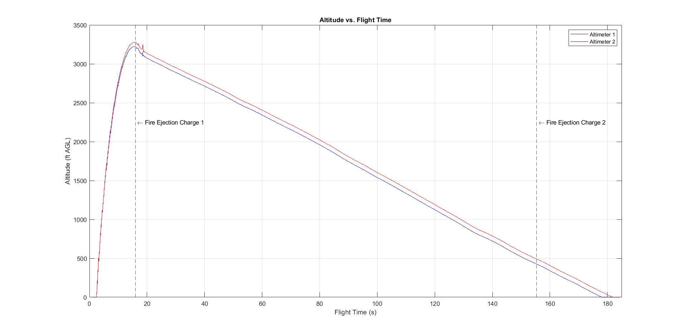
Post-Flight Data Analysis
Predicted Altitude: 3,182 ft
Achieved Altitude: 3,279 ft
Deviation = 3.05%

Slide 19
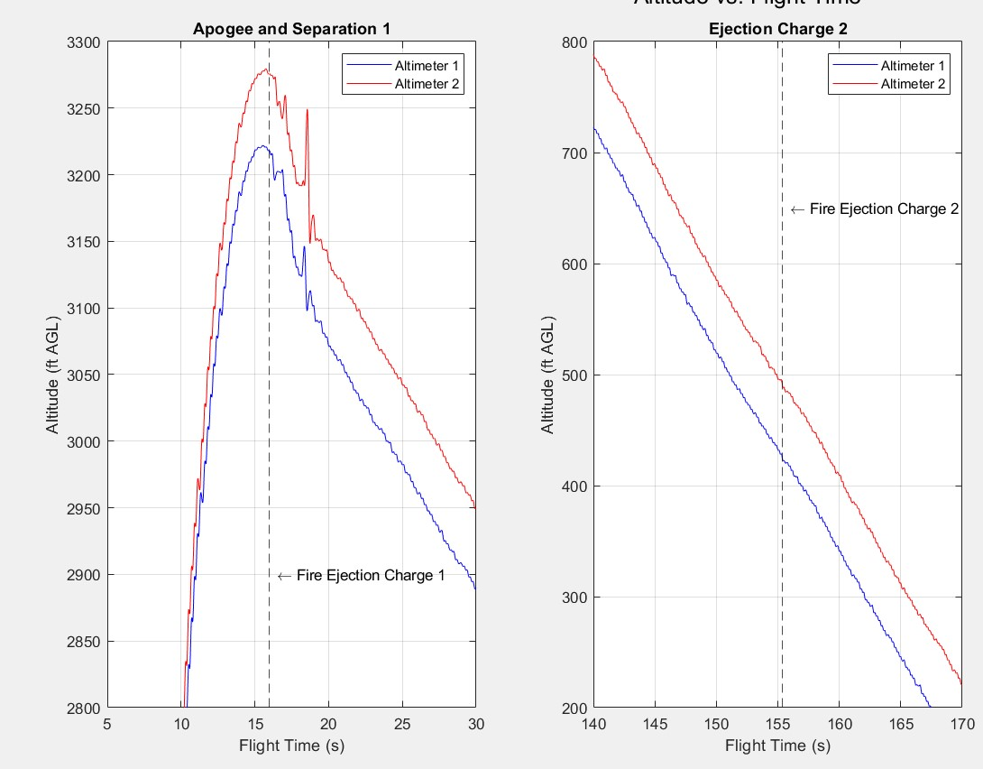
Post-Flight Data Analysis

Slide 20
Future Work

Slide 21
Completed and In-Progress (Spring)
NASA Student Launch Milestones:
Critical Design Review (CDR)
Technical Report
Final design selection for Vehicle and Payload
Subscale Vehicle Flight Test
Slide Presentation (02/04/2023)
Due Jan. 9, 2023
STEM Engagement Activities
Flight Readiness Review (FRR)
Technical Report
Full Scale Launch Vehicle and Payload demonstration flights
STEM Engagement Completed
Slide Presentation
Due March. 6, 2023
Senior Design Milestones:
Risk Assessment
Complete by: 03/03/2023
Operation Manual
Assembly and ops checklists complete
Full instruction manuals in progress
Complete by: 03/03/2023
Web Page
Complete by: 03/31/2023
Engineering Design Day
Presentation: 04/06/2023
Final Report
Complete by: 04/21/2023

Slide 22
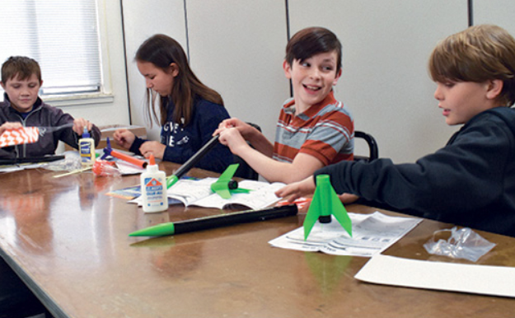
STEM Engagement Plan
Schools:
Gilchrist Elementary School
School of Arts and Sciences (K-8)
Pineview Elementary School
Maclay School (K-12)
Griffin Middle School
Augusta Raa Middle School
Fairview Middle School
Leon High School
Sail High School
Godby High School
Activities:
Elementary
Small lecture of airplane design followed by paper airplane distance competition
Water rocket group projects
Middle
Small lecture on drag followed by parachute racing competition
Aerodynamics lecture and foam glider design competition
High
Aerodynamics/propulsion lecture
Present subscale vehicle and discuss NASA Student Launch high-school division
Connect students with other partner RSO’s for resume building and mentoring

Slide 23
STEM Engagement Types
Education-Direct Engagement
Hands-on activities where participants engage in learning a STEM related concept
Education-Indirect Engagement
Participants are engaged in learning a STEM concept through instructor-led presentations
Outreach-Direct Engagement
Participants don’t learn STEM concepts but get hands-on exposure to STEM related topics or hardware.
Outreach-Indirect Engagement
Participants will interact with team members in an informal setting

Slide 25
COPY THIS SLIDE
Point
Point

Slide 26
COPY THIS SLIDE!

